Slide 1
Team 1 UI Design
Aung Ko Ko Khant (A0249480X)
Aye Mya Phoo (A0249473U)
Cheong Li Yuan (A0144049H)
Khan Sher Mostafa Somik (A0249468L)
Nyan Htet Win Maung (A0249498E)
Xie Ting Ting (A0249501J)
Zhao Ziyou (A1084806X)

Slide 2
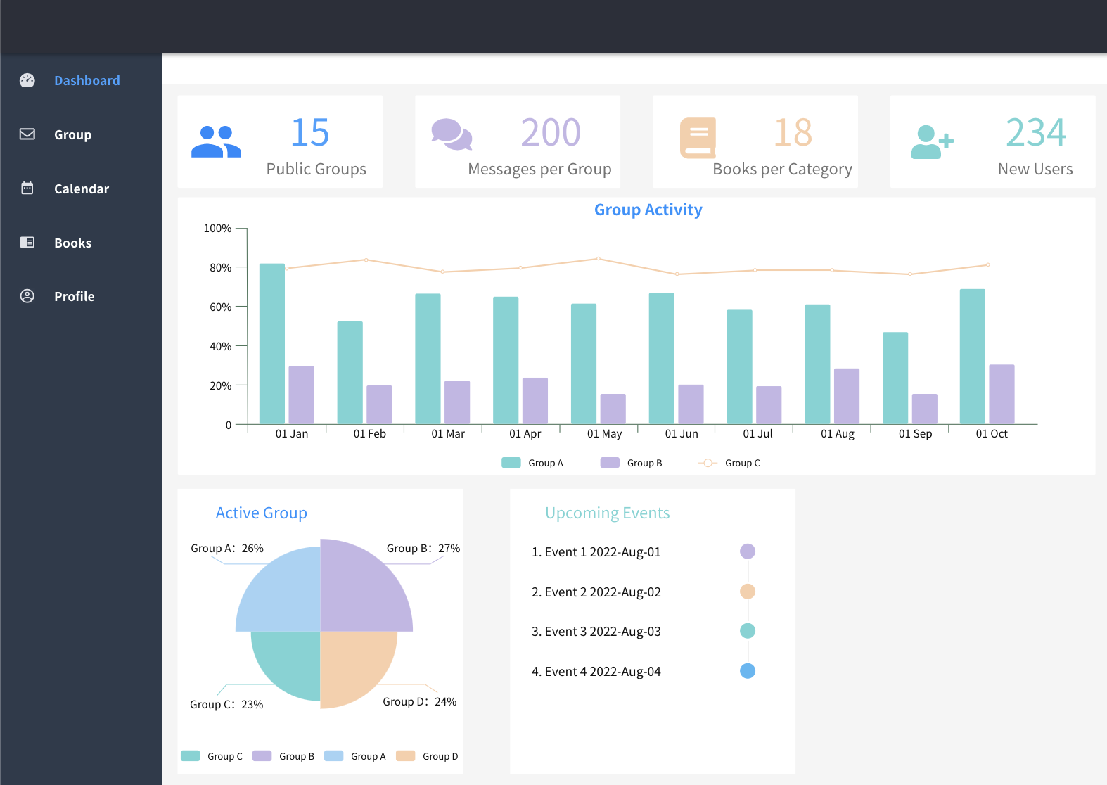
Dashboard
This dashboard is used to display our key metrics.

Slide 3

01
Android Design

Slide 4
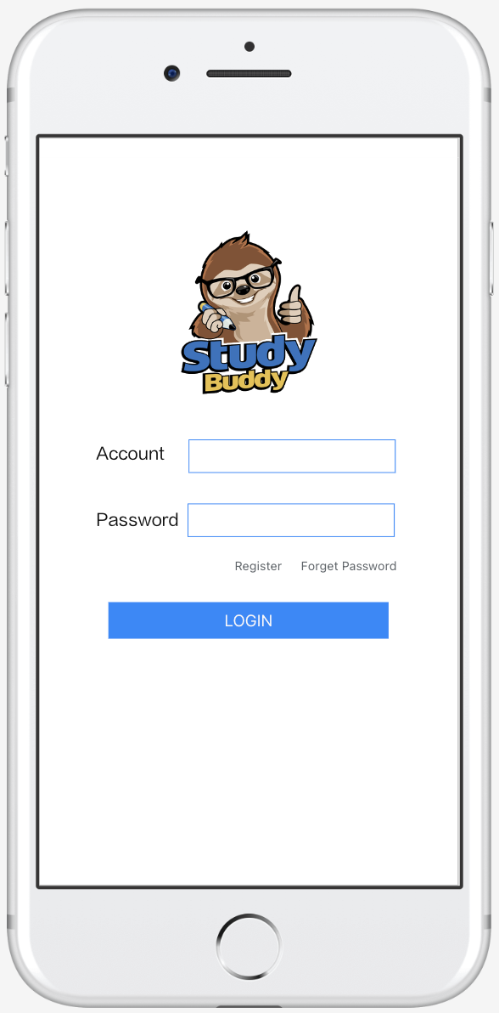
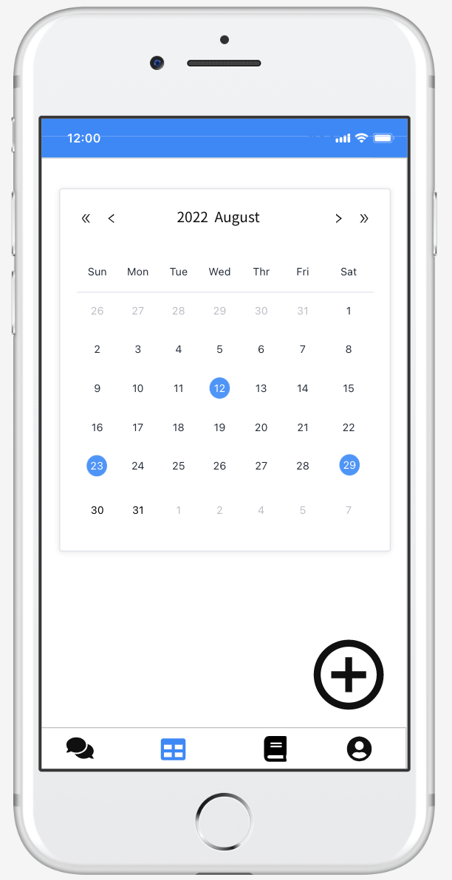
Login Page
Calendar Page
User can log in from here
Click any highlighted date on the calendar all the events on that date which is also the Join event screen will pop up. Once click the “+” button on the calendar view, the add event screen will pop up.

Slide 5
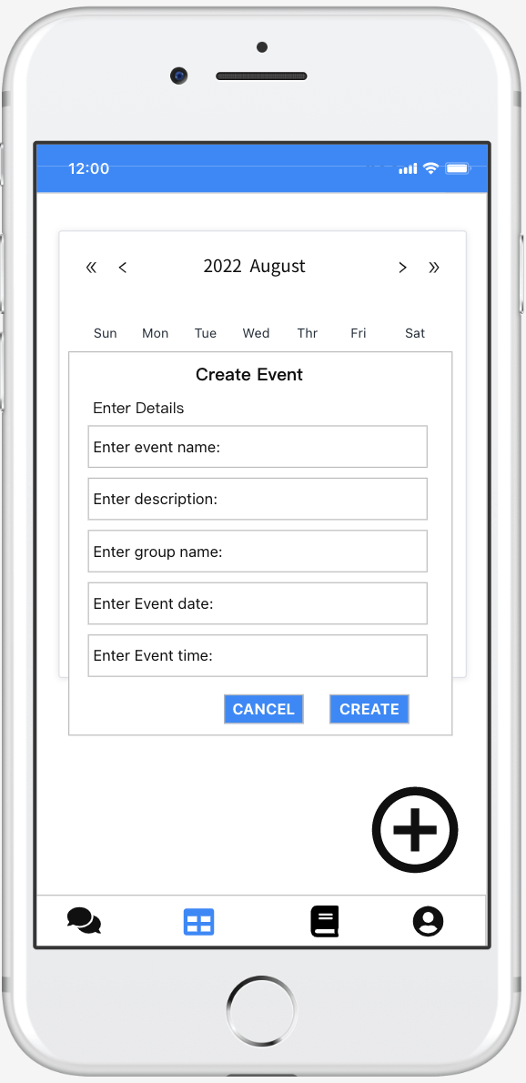
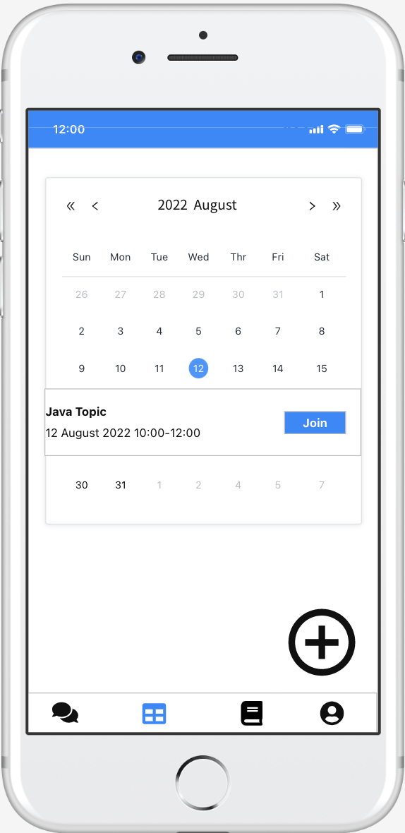
Create Event Page
Join Event Page
Creator can create an event by entering the event details then click create. They can also cancel the event creation if they changed their mind.
User can view all the events on that day and can click the join button if they are interested in that topic to join the study group.

Slide 6
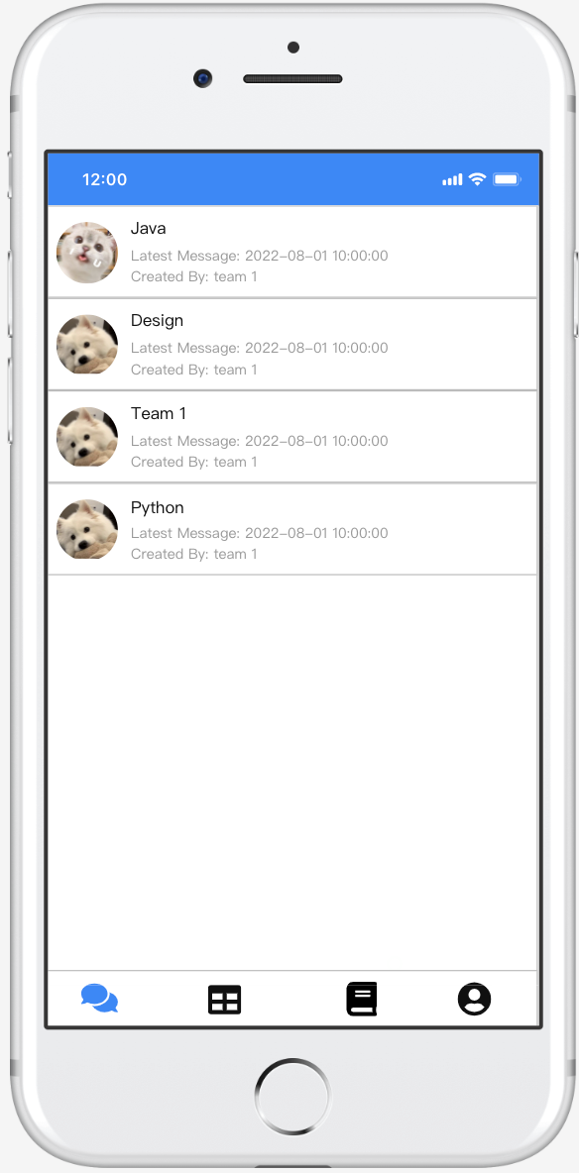
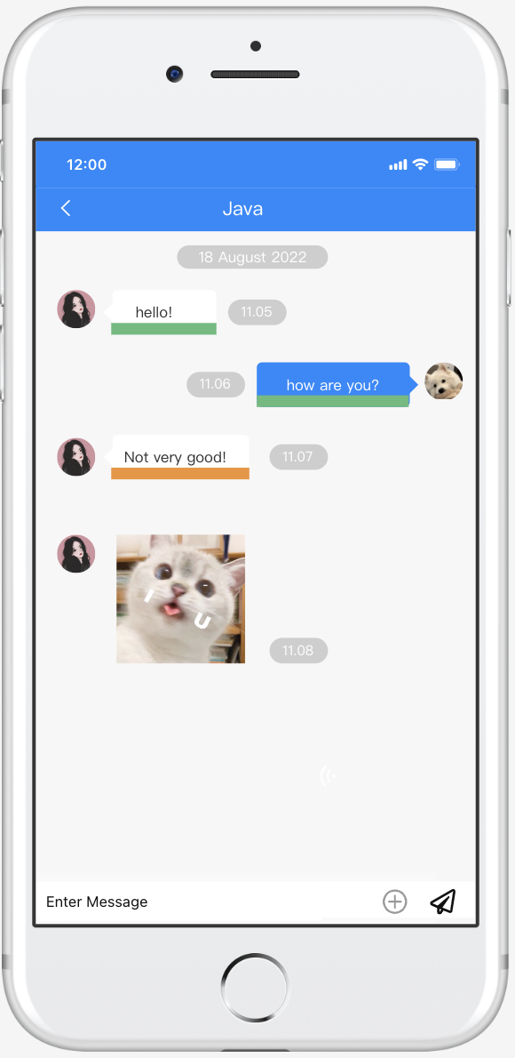
Group Page
Chat Page
Groups with group name and creator name will be shown. The date and time of the latest message for each group will also be shown.
User can write message and click the send button to send message. When click the “+”button user can attach files. Message will be underlined with different colour based on the message text.

Slide 7
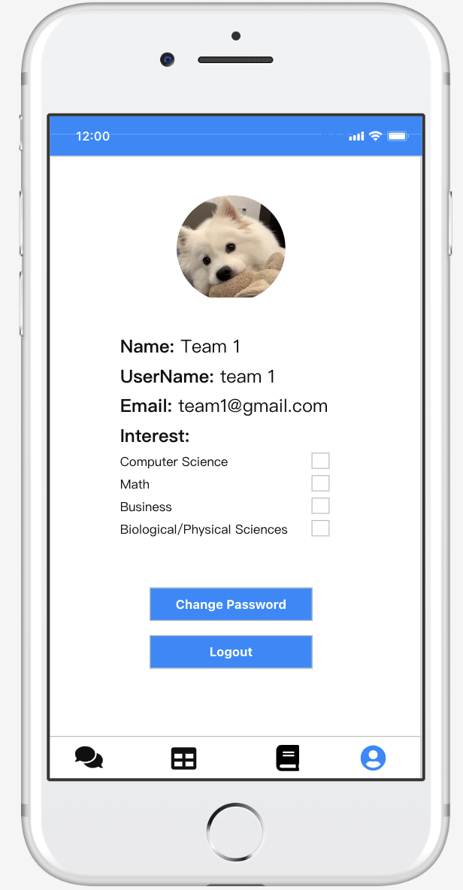
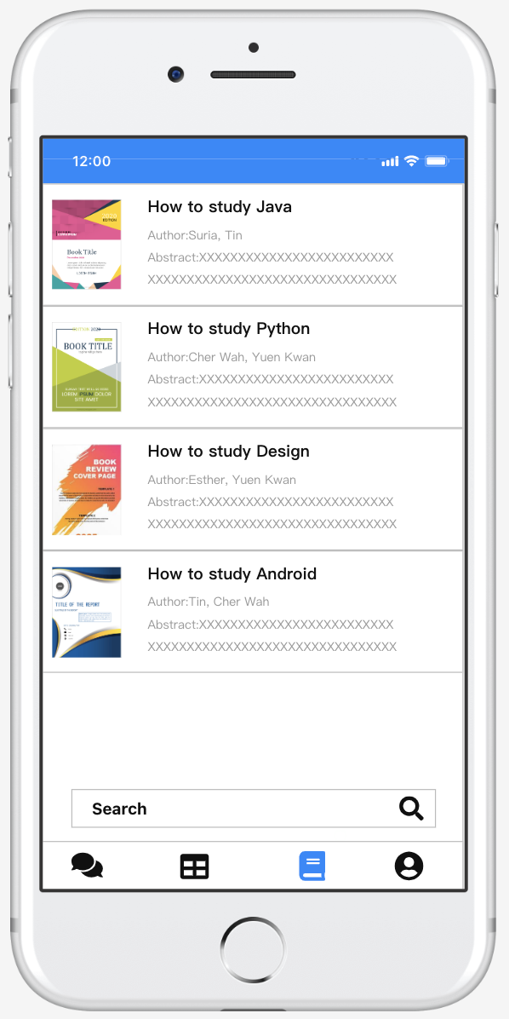
Profile Page
Book Page
User can view their profile page and change profile photo. Interest can be changed by click on different checkbox. One or more options can be chosen.
User can enter keyword in the search box to look for books. And books recommended to the user is based on the interest of the user.

Slide 8
02
Web Design

Slide 9
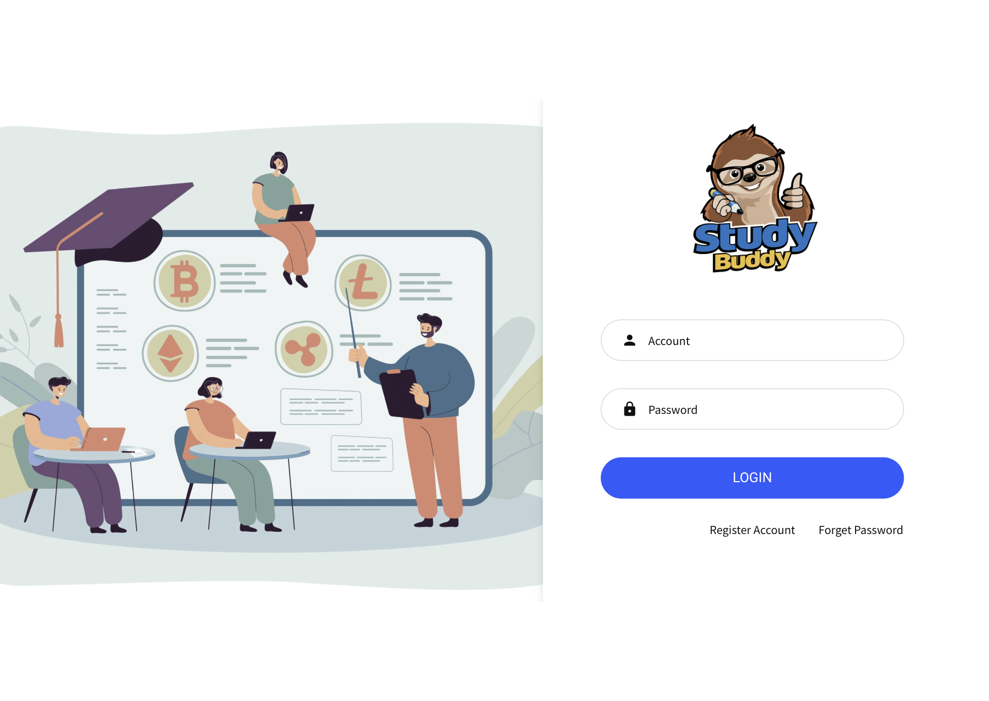
Login Page
User can log in from here

Slide 10
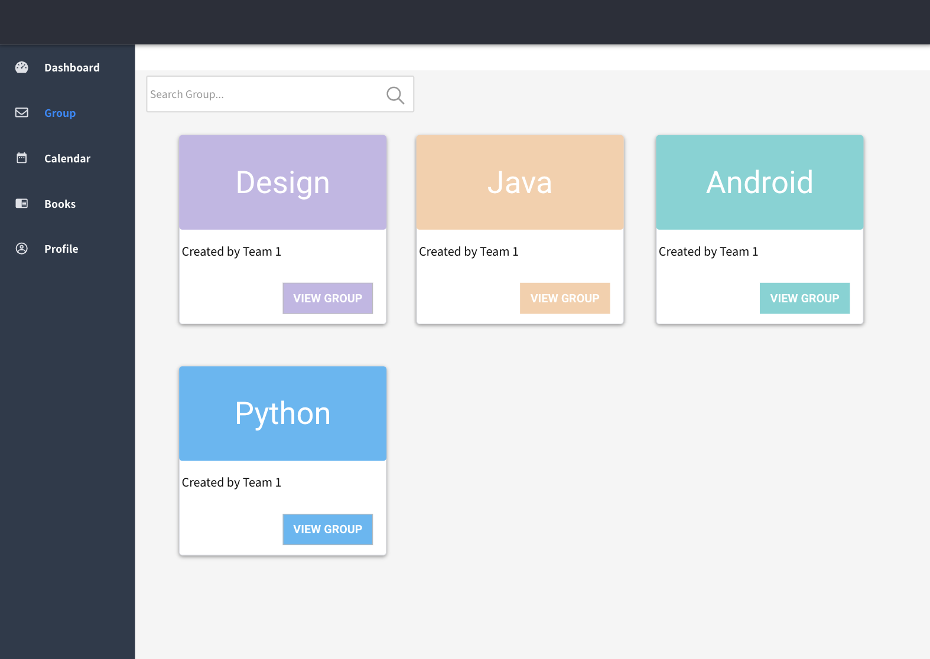
Group Page
Groups with group name and creator name will be shown. User can join in the chat by clicking the view group.

Slide 11
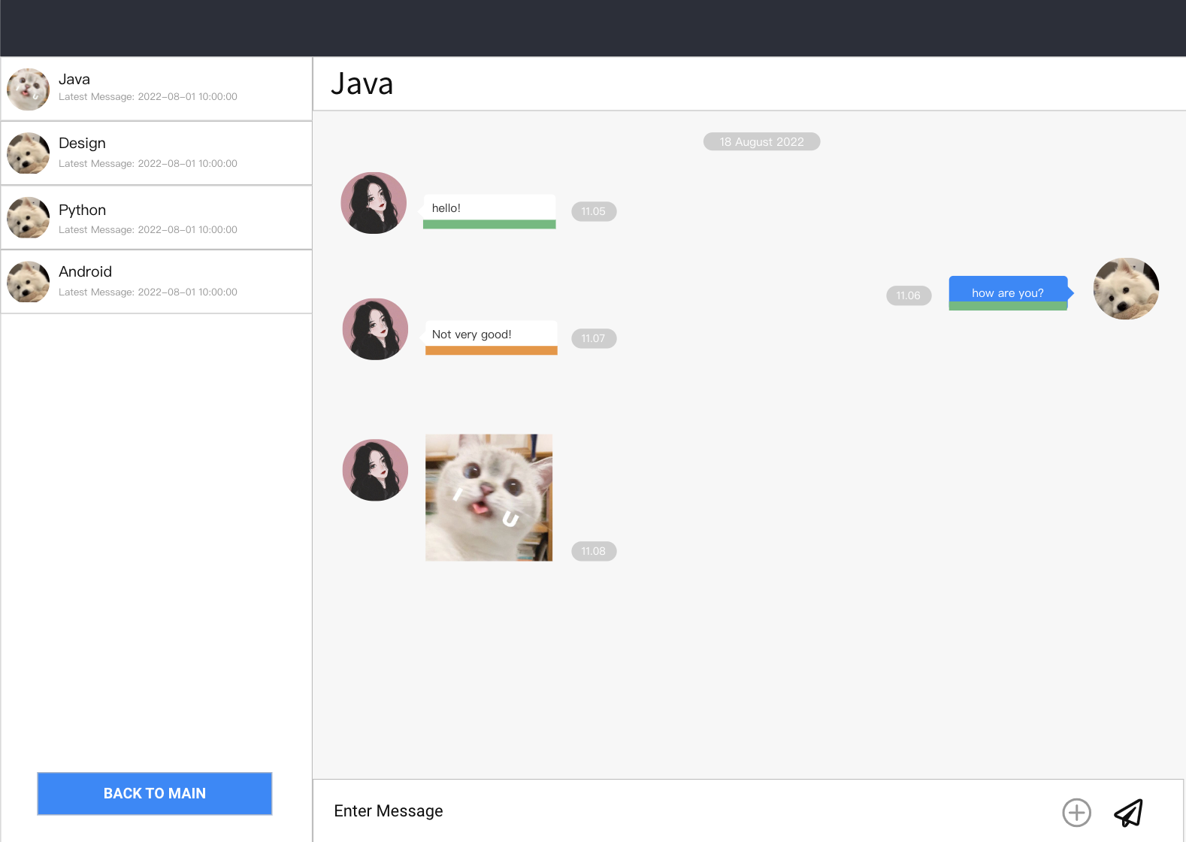
Chat Page
User can write message and click the send button to send message. When click the “+”button user can send picture, video or file. Message will be underlined with different colour categories based on the message text.

Slide 12
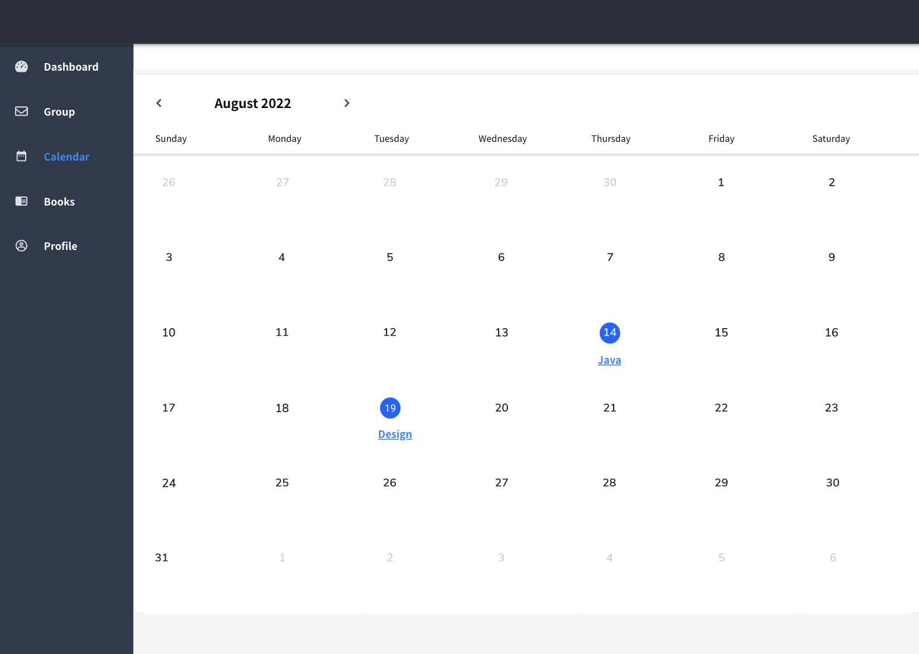
Calendar Page
User can view all the create events on the calendar view. User can join events by click on the created event name. User can create event by clicking on the empty space of a date on the calendar.

Slide 13
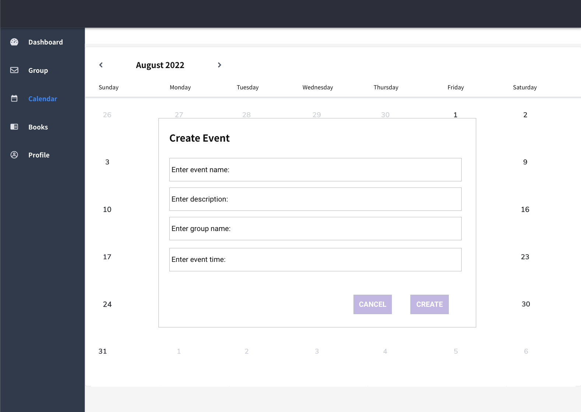
Create Event
Creator can create an event by entering the event details then click create. They can also cancel the event creation if they changed their mind.

Slide 14
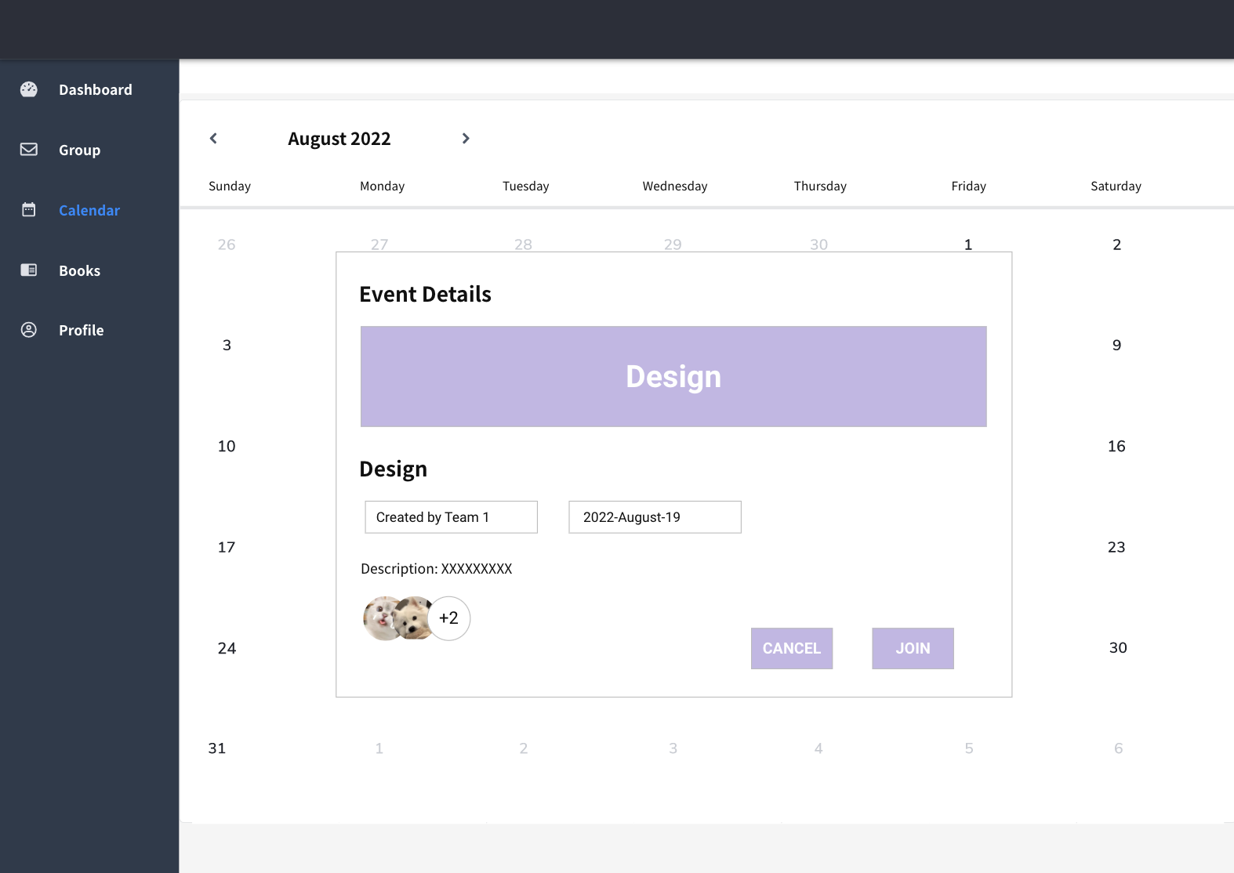
Join Event Page
User can view event details and can click the join button if they are interested in that topic to join the study group. Or click cancel button if they don’t want to join the group.

Slide 15
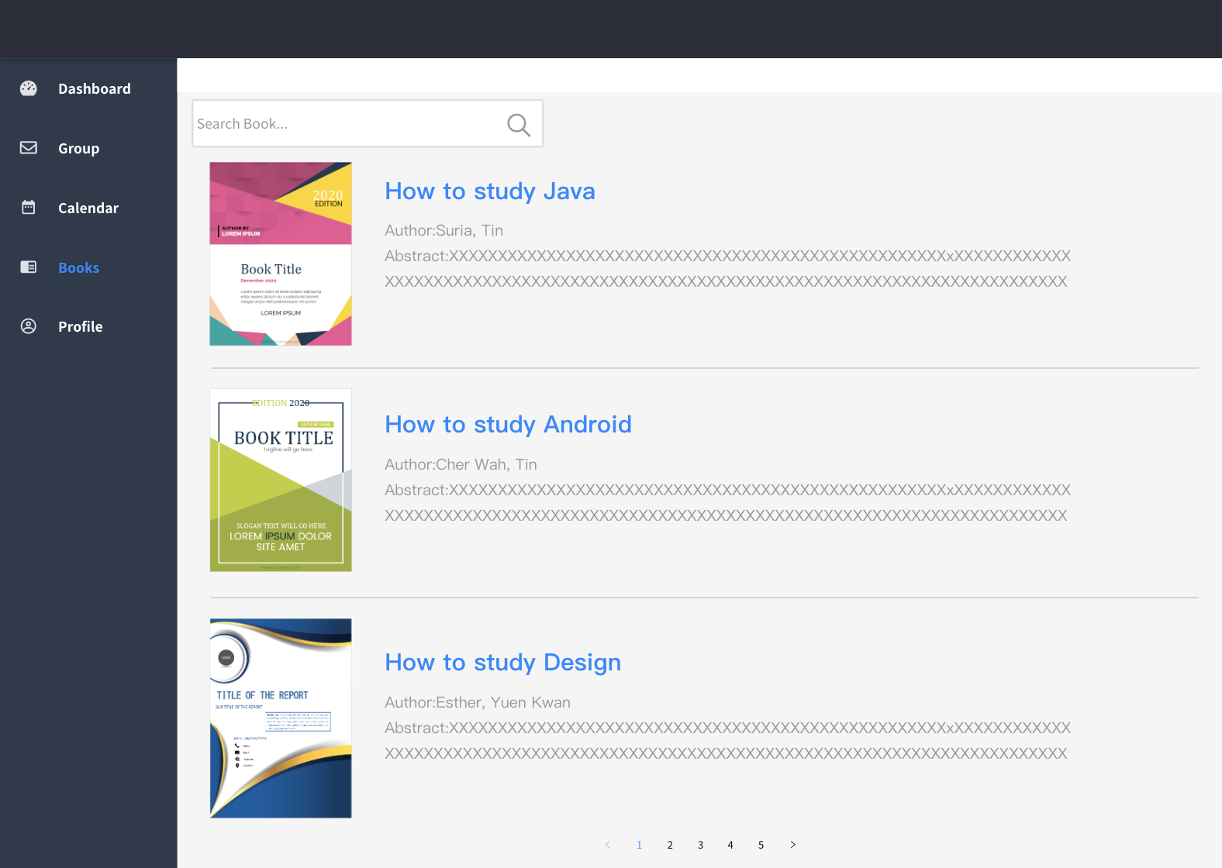
Book Page
Books with cover page, title, author and abstract will be shown on each screen. User can enter keyword in the search box to look for books. Pagination will be used to next page.

Slide 16
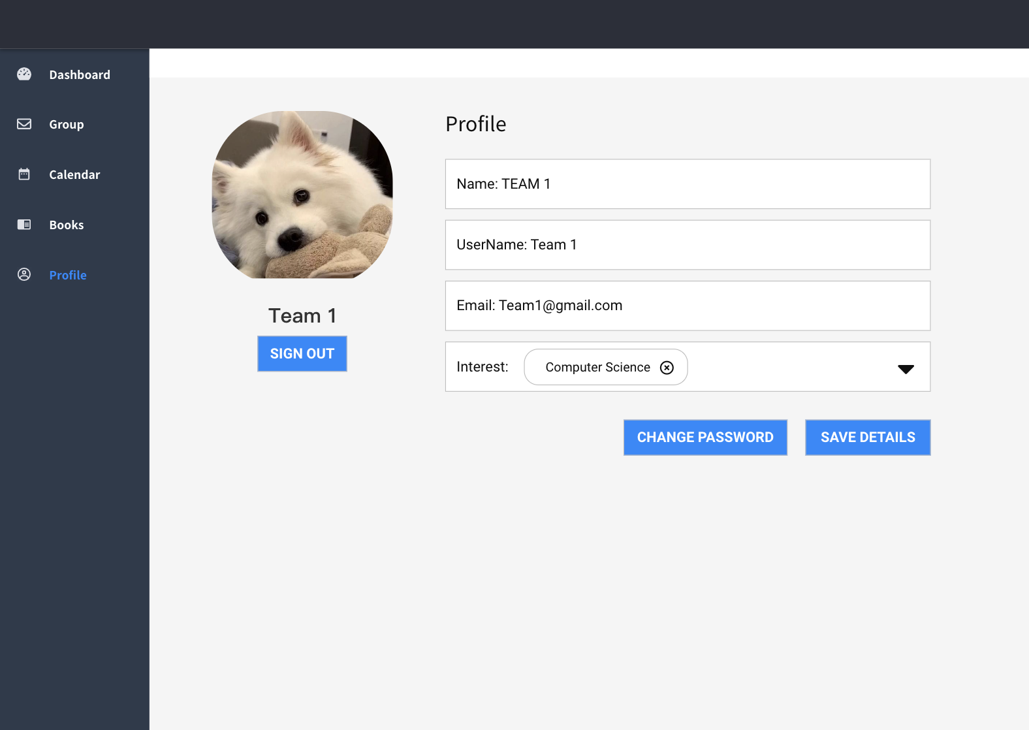
Profile Page
User can view their profile page. Interest can be chosen by click on drop down button and can be removed by clicking the “x”. One or more interests can be chosen.

